Slide 1

ROCKBUSTER’s Top performers
Rockbuster’s Headquarters
November, 2022
by Elena Dries

Slide 2
Statistics
Variables | Min. Value | Max. Value | Average Value
Rental Duration, days | 3 | 7 | 5
Rental Rate, $ | $0.99 | $4.99 | $2.98
Length, minutes | 46 | 185 | 115
Replacement Cost, $ | $9.99 | $29.99 | $19.98
Basic statistics for the main numeric variables are as follows:

Slide 3
Variables modal values
Variable | Modal Value
Film Rating | PG-13
Film Release Year | 2006
Film Language ID | 1
Film Entry Last Update | 5/26/2013 2:50:59 PM
Store ID | 1
Customer First Name | Jamie
Customer Last Name | Abney
Customer E-mail | aaron.selby@sakilacustomer.org
Customer Address ID | 5
Customer Active Boolean | TRUE
Customer Entry Create Date | 2/14/2006
Customer Entry Last Update | 2013-05-26 14:49:45.738
Customer Active Status | 1
Modal (most frequently occurring) values for the
non-numeric variables are as follows:

Slide 4
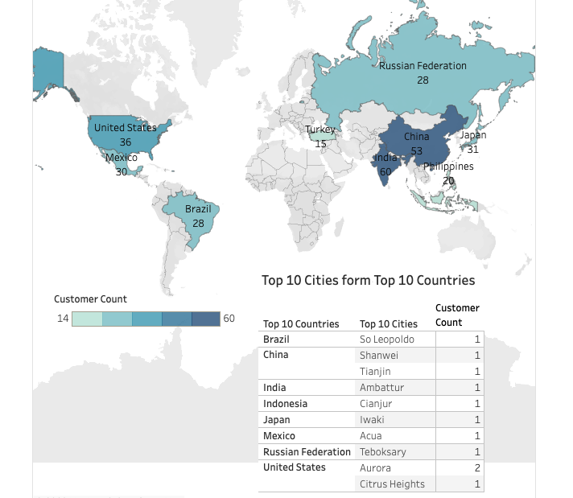
Top 10 cities frOm top 10 countries
Top 10 cities from the top 10 countries by the number of customers:

Slide 5
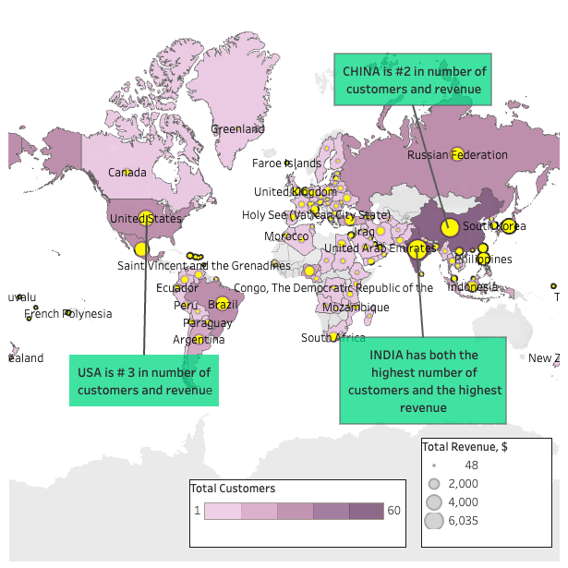
Total customers & revenue
Geographical distribution of customers counts, as well as of generated revenues:

Slide 6
TOP 5 CUSTOMERS
Customer ID | Customer First Name | Customer Last Name | Country | City | Total Amount Paid, $
225 | Arlene | Harvey | India | Ambattur | $111.76
424 | Kyle | Spurlock | China | Shanwei | $109.71
240 | Marlene | Welch | Japan | Iwaki | $106.77
486 | Glen | Talbert | Mexico | Acua | $100.77
537 | Clinton | Buford | United States | Aurora | $98.76
Top 5 customers in the top 10 cities, who have paid the highest total amounts to Rockbuster.

Slide 7
Tableau url
https://public.tableau.com/app/profile/elena.dries/
viz/3_10byElenaDries/Story1?publish=yes
The link for the Tableau Public visualizations.

